Slide 1
Final Project-606
Airbnb Price Prediction using Machine Learning
Sujith Cholleti
Ashish Kesari
Harini Payala

Slide 2
Introduction
Airbnb, founded in 2008, is a global online marketplace connecting travelers with unique lodging options offered by hosts, ranging from apartments to treehouses, in over 220 countries and regions.
This platform revolutionized travel by offering personalized and authentic experiences, allowing hosts to earn extra income while providing guests with affordable accommodations and fostering a community built on trust and reviews.

Slide 3

Why This Project?
This project aims to predict Airbnb prices using machine learning techniques.
This project would be beneficial to both customers and new Airbnb hosts. Customers can make informed decisions about booking their favorite spot based on predicted prices. For new Airbnb hosts, it provides insights into setting competitive prices in the market.

Slide 4
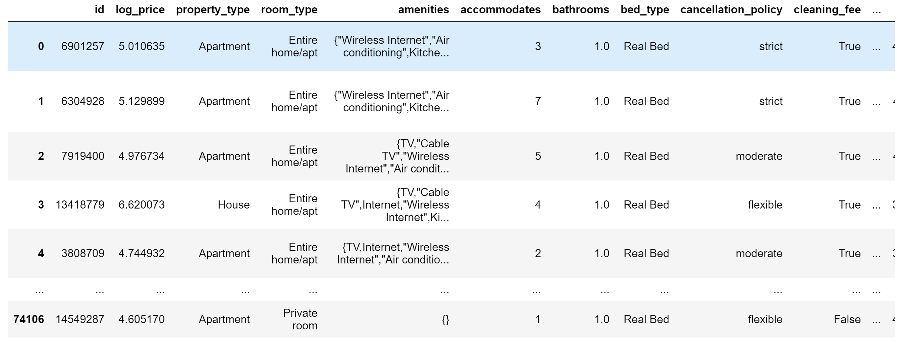
About Data Set
Sources:
Kaggle (Air bnb Data set)- df
Zillow.com(residential price data set) – df1
Basic Data Set Structure

Slide 5
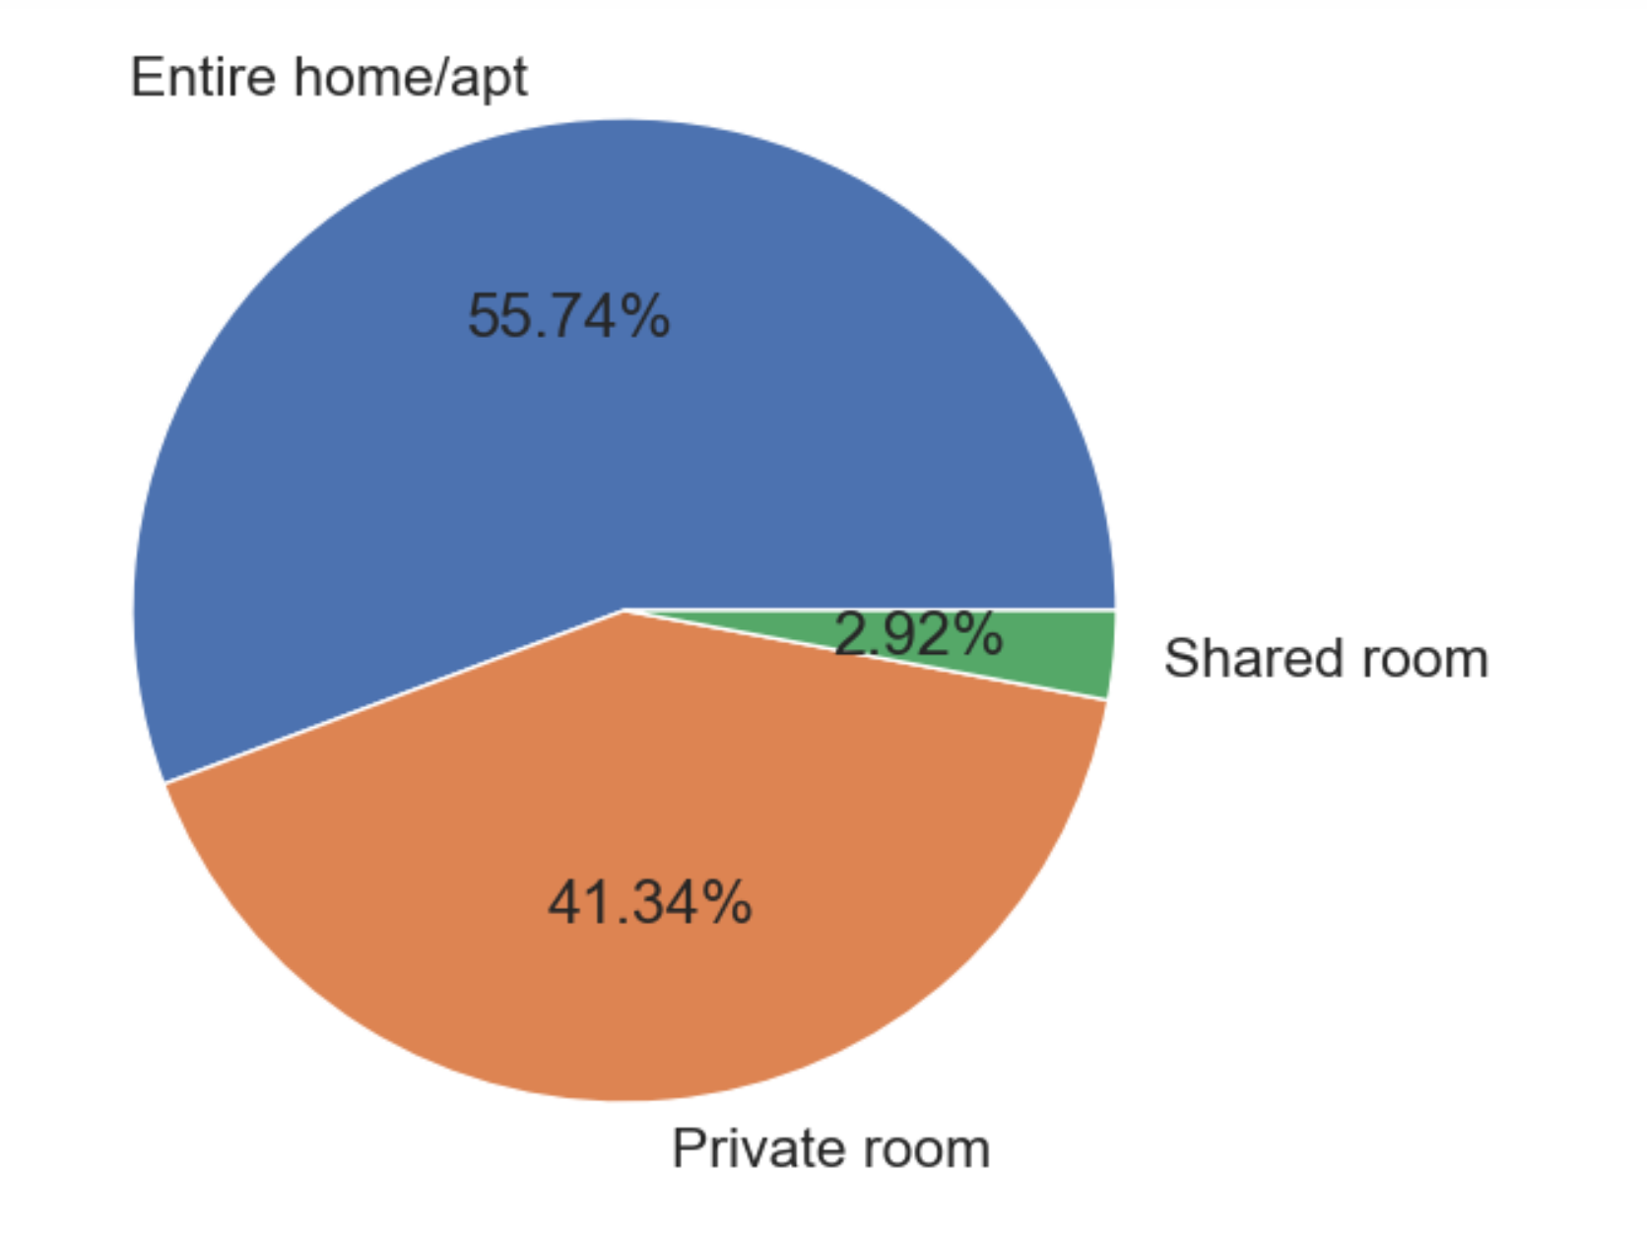
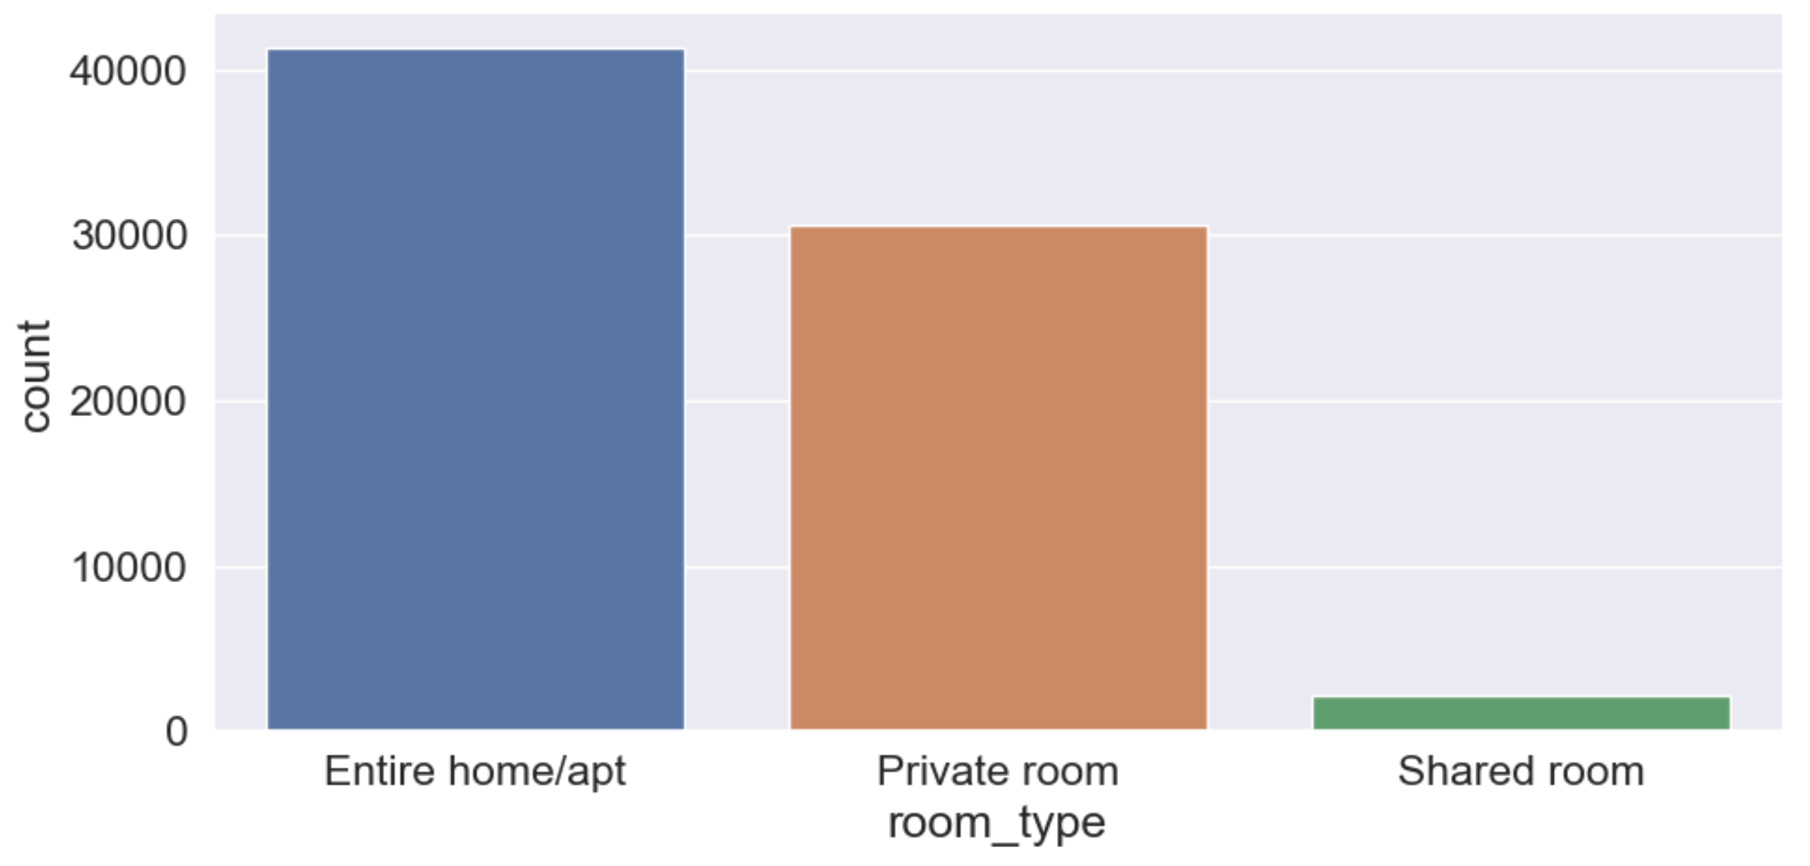
Type of properties

Slide 6
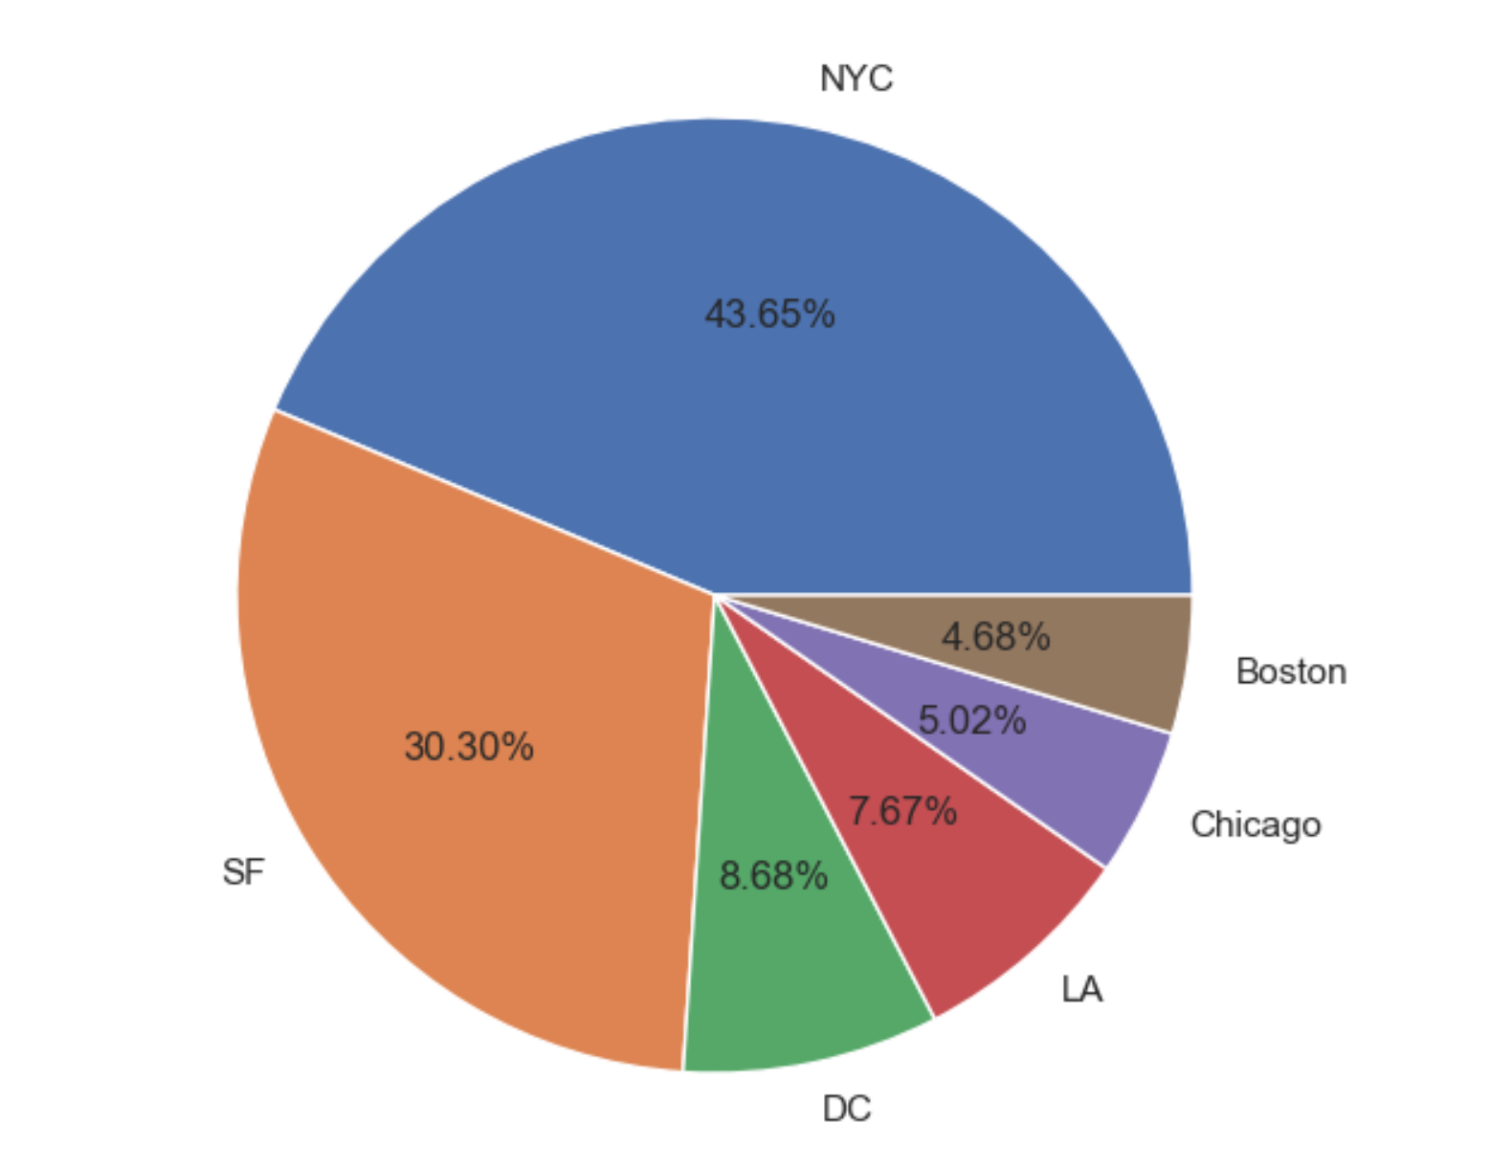
Top Cities

Slide 7
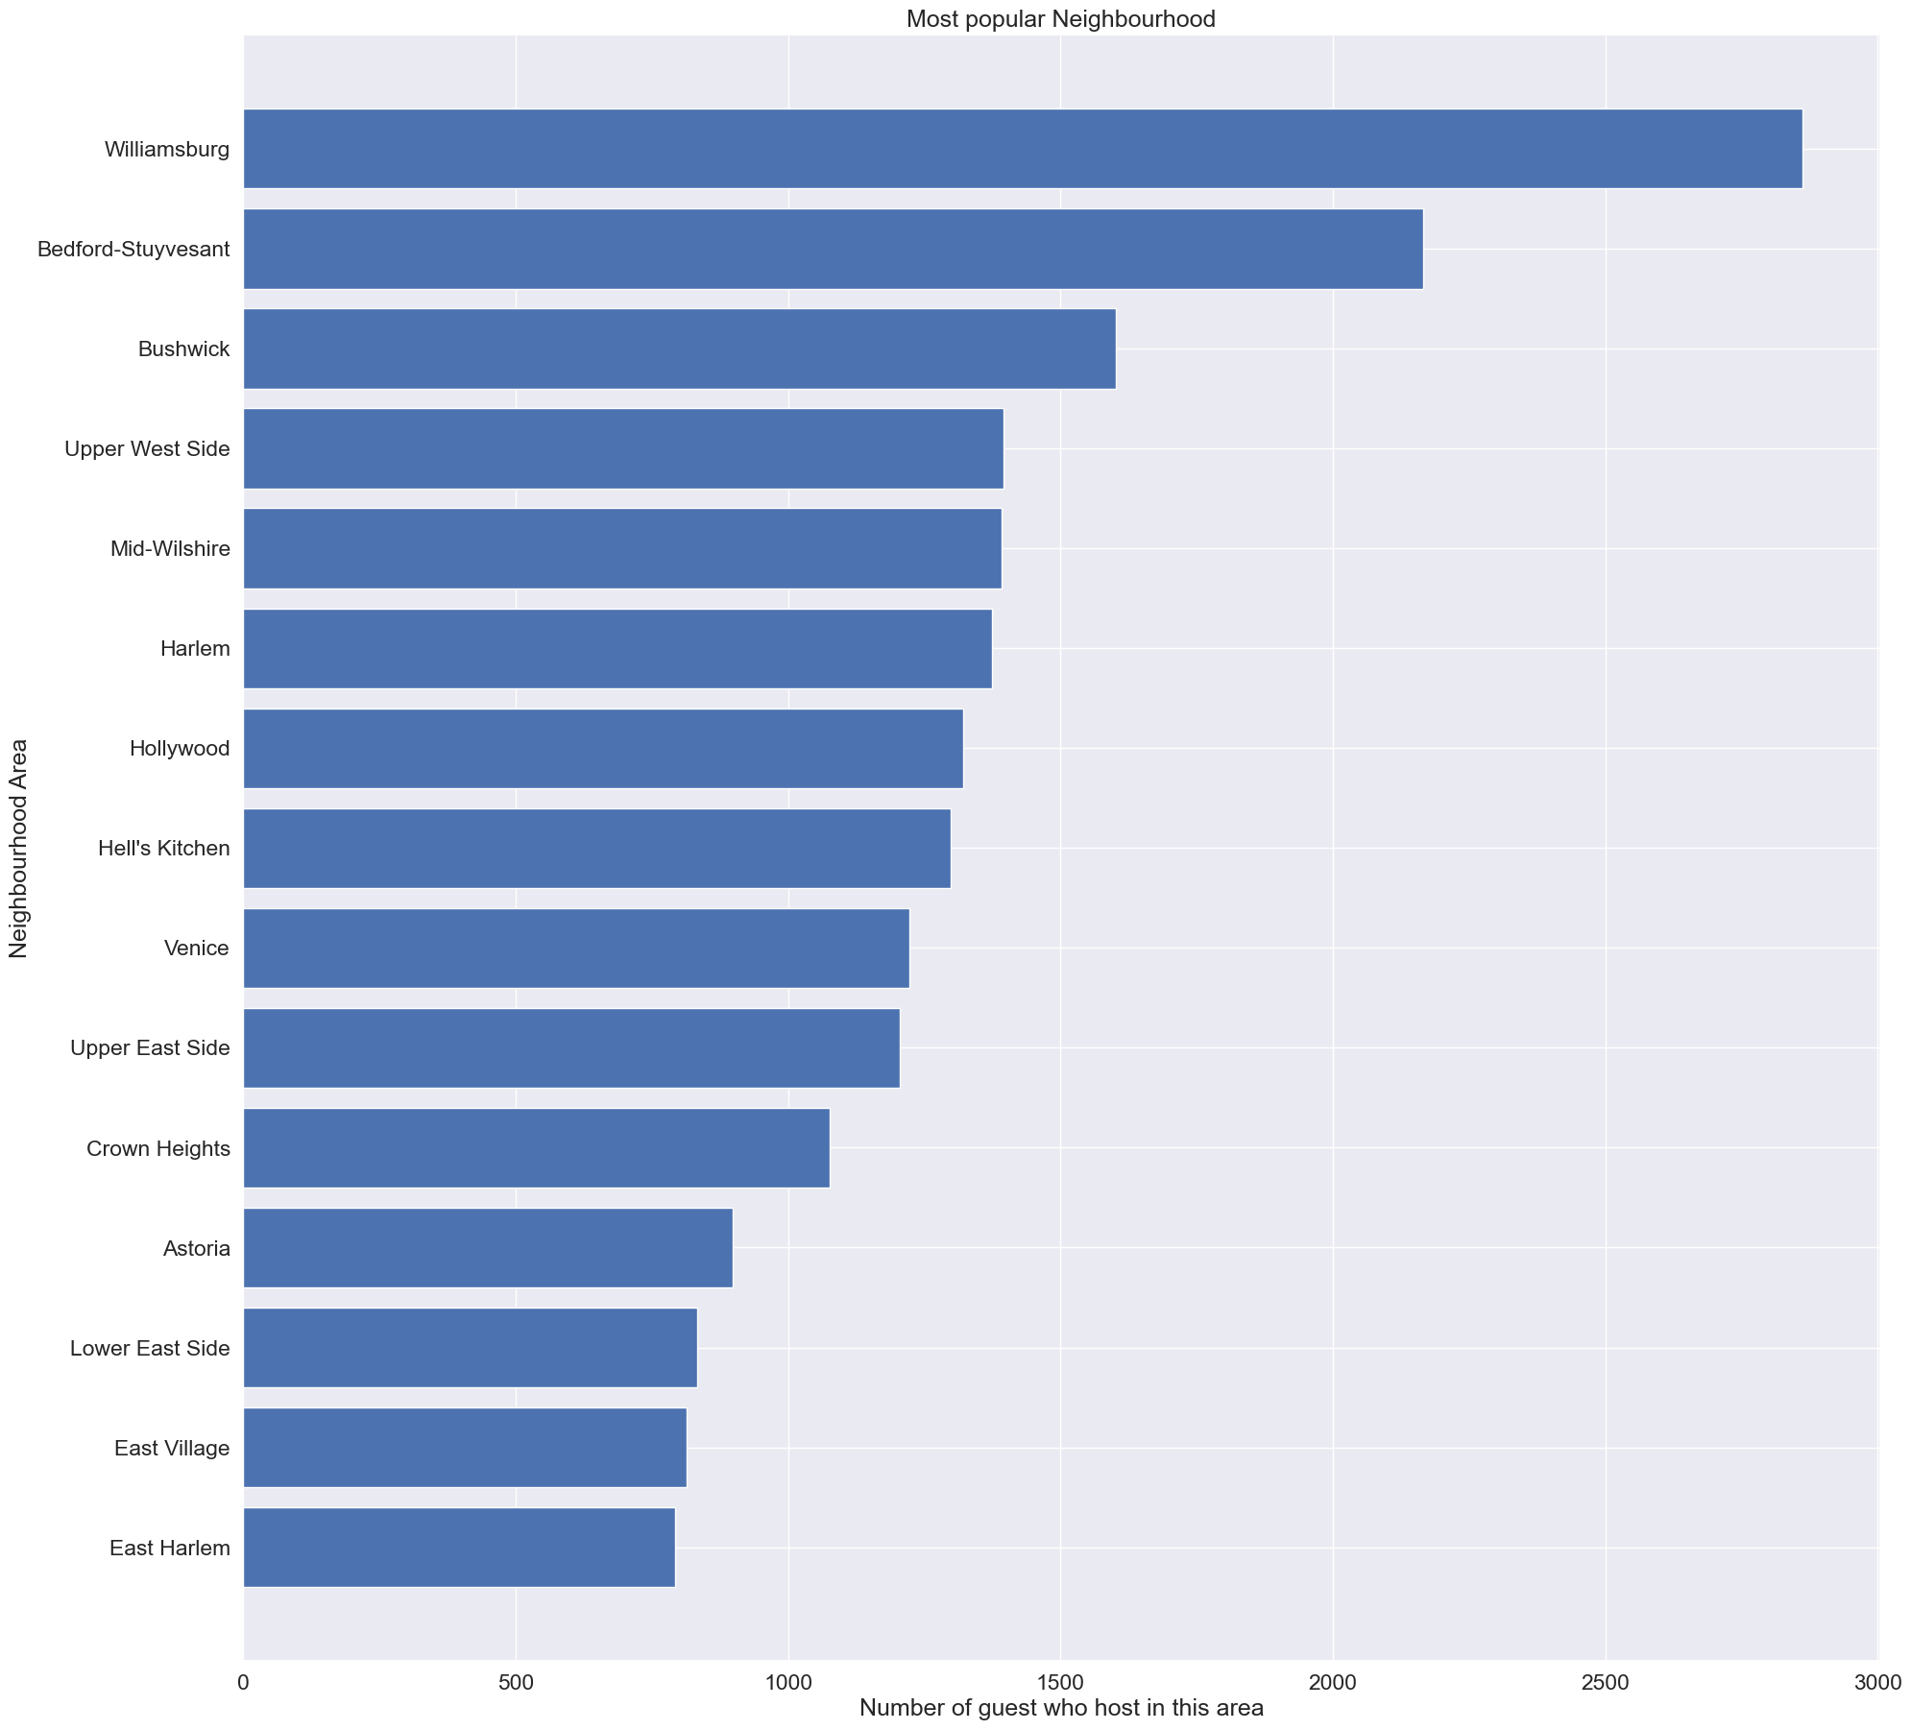
Most popular Neighborhood

Slide 8
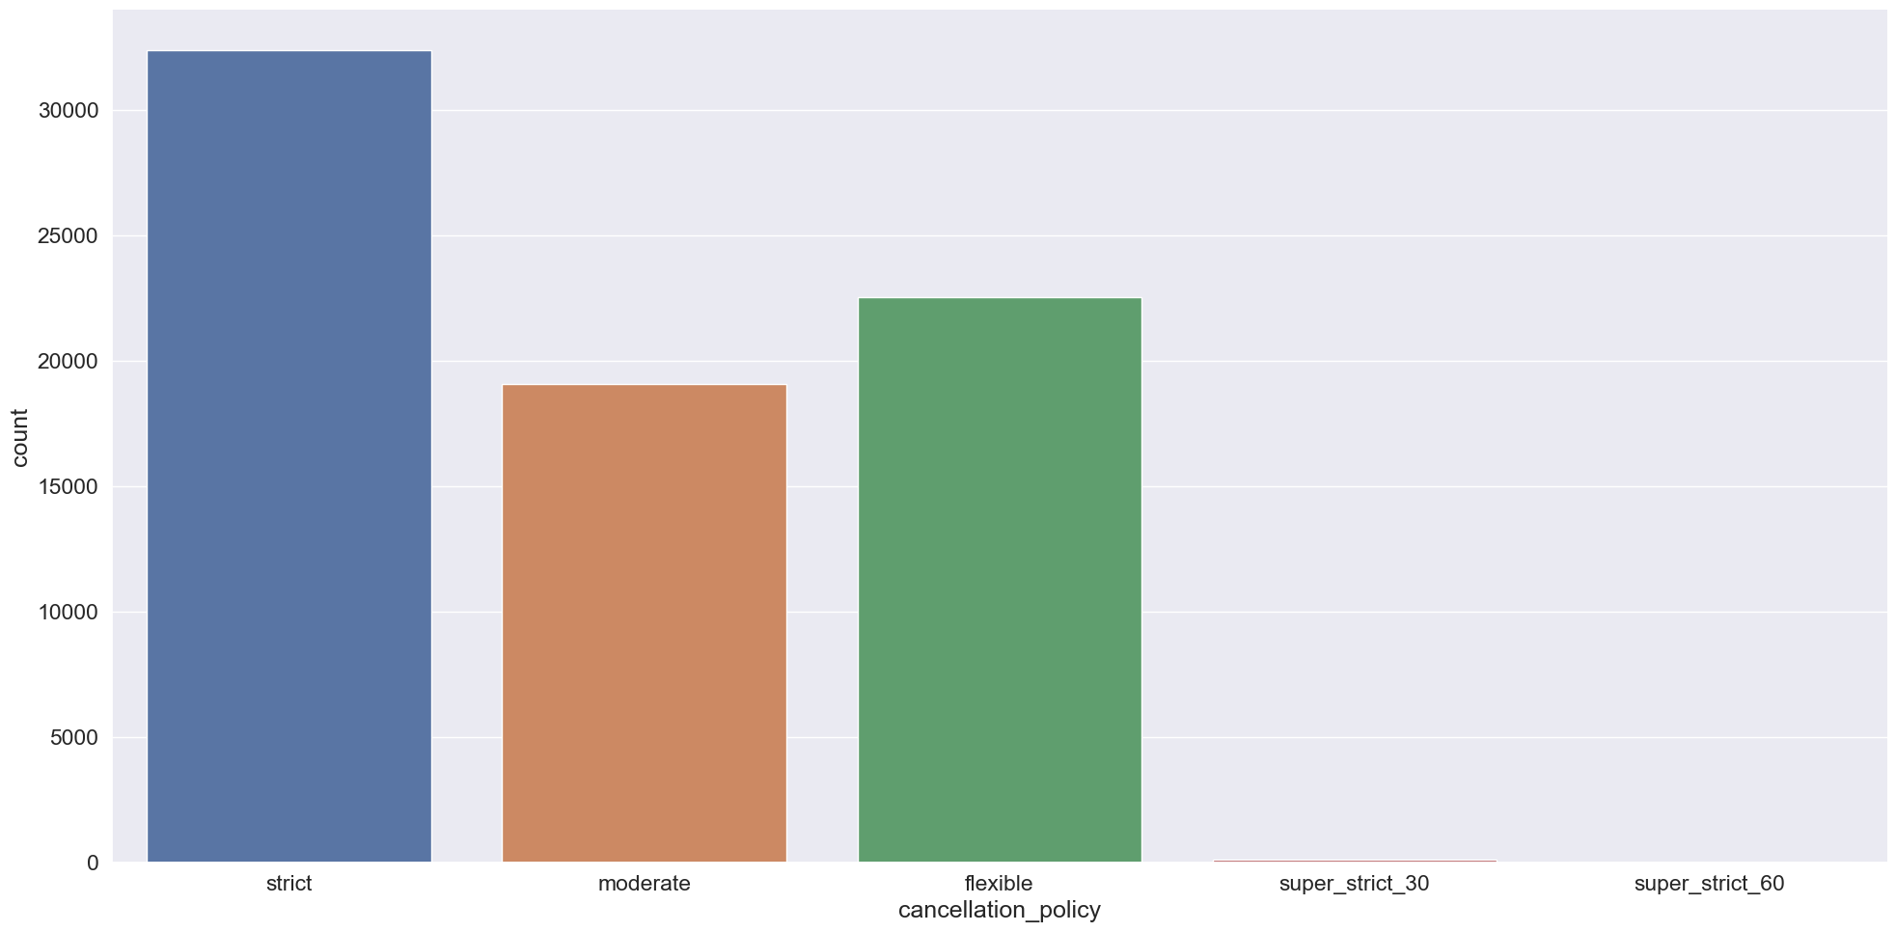
Cancellation Policy

Slide 9
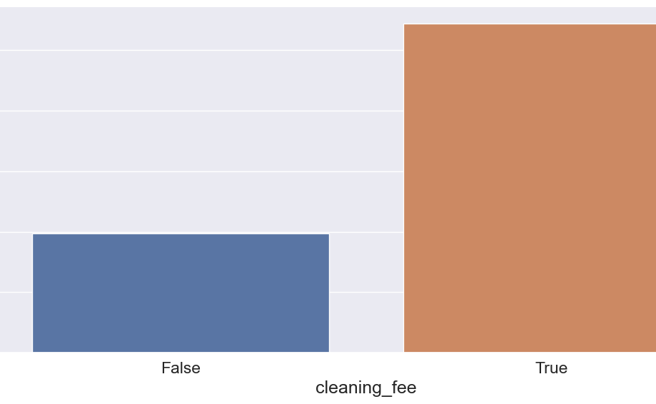
CLEANING FEE

Slide 10
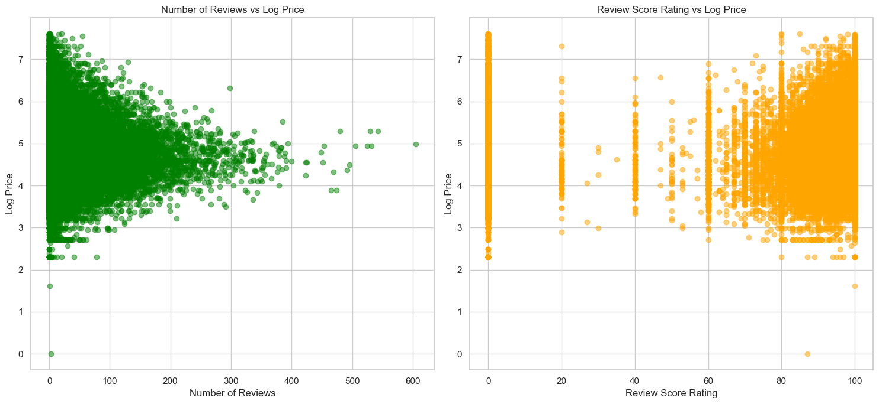

Slide 11
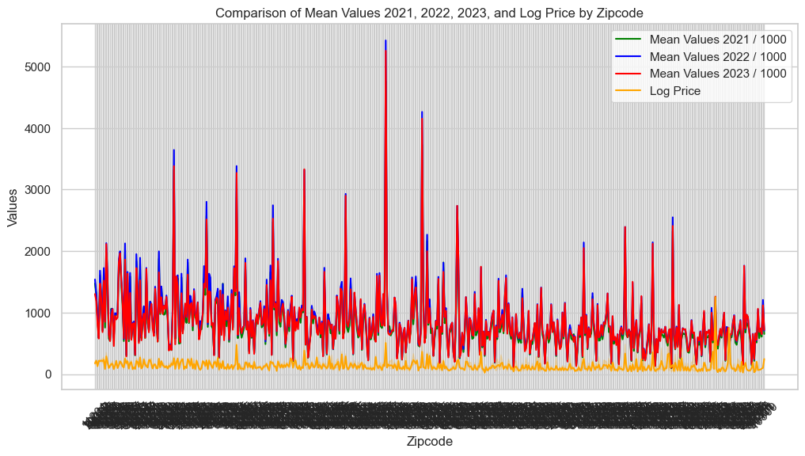
COMPARISON OF MEAN VALUES

Slide 12
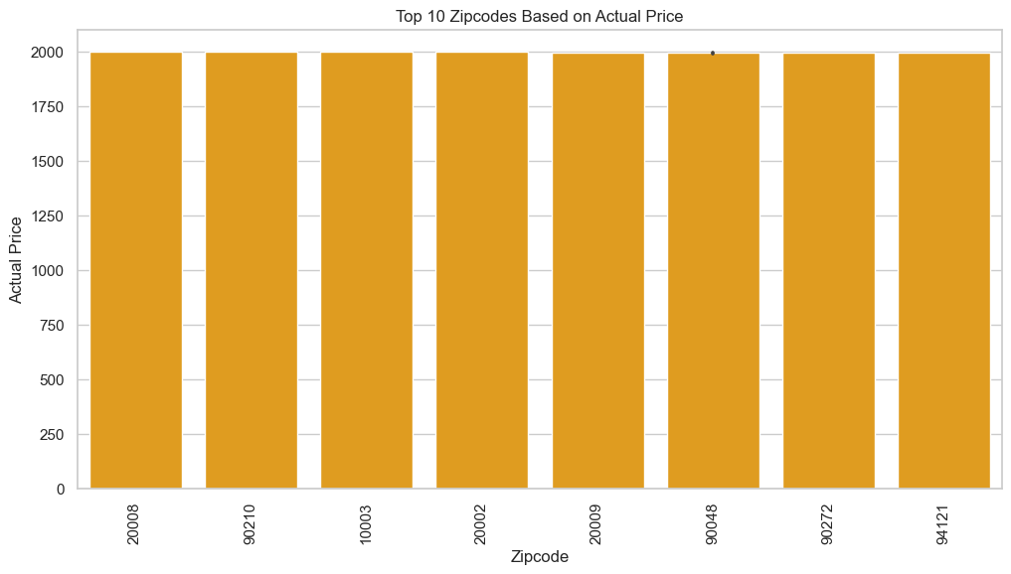
Top-10 Zip codes (ACTUAL PRICE)

Slide 13
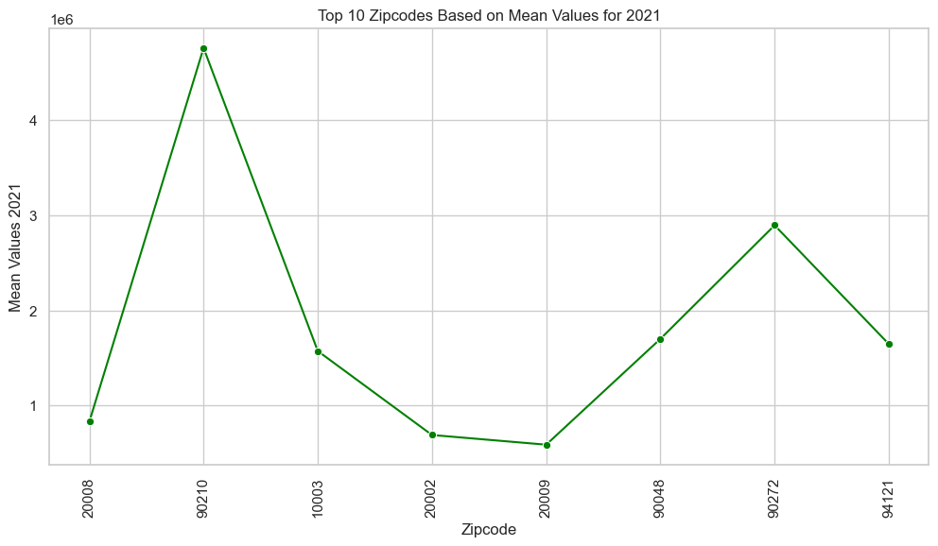
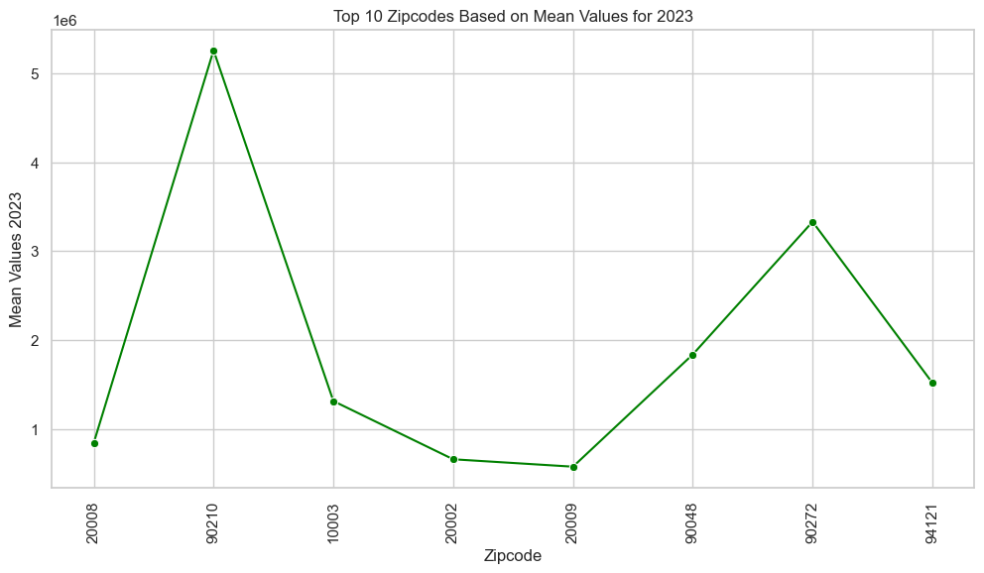
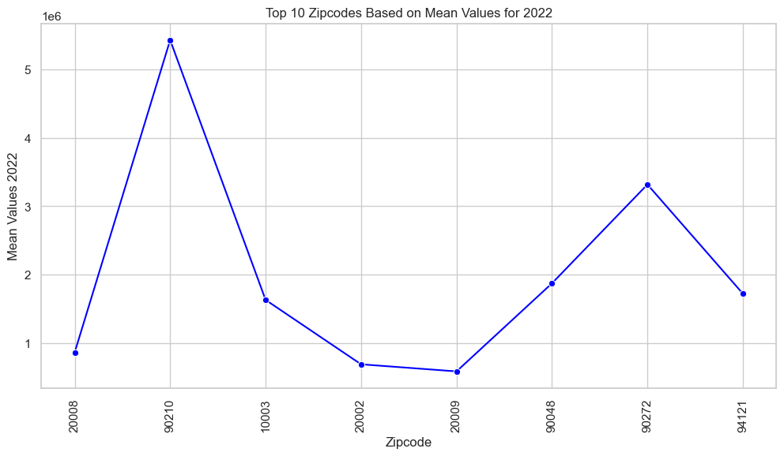
Top 10 zipcodes based on mean values

Slide 14
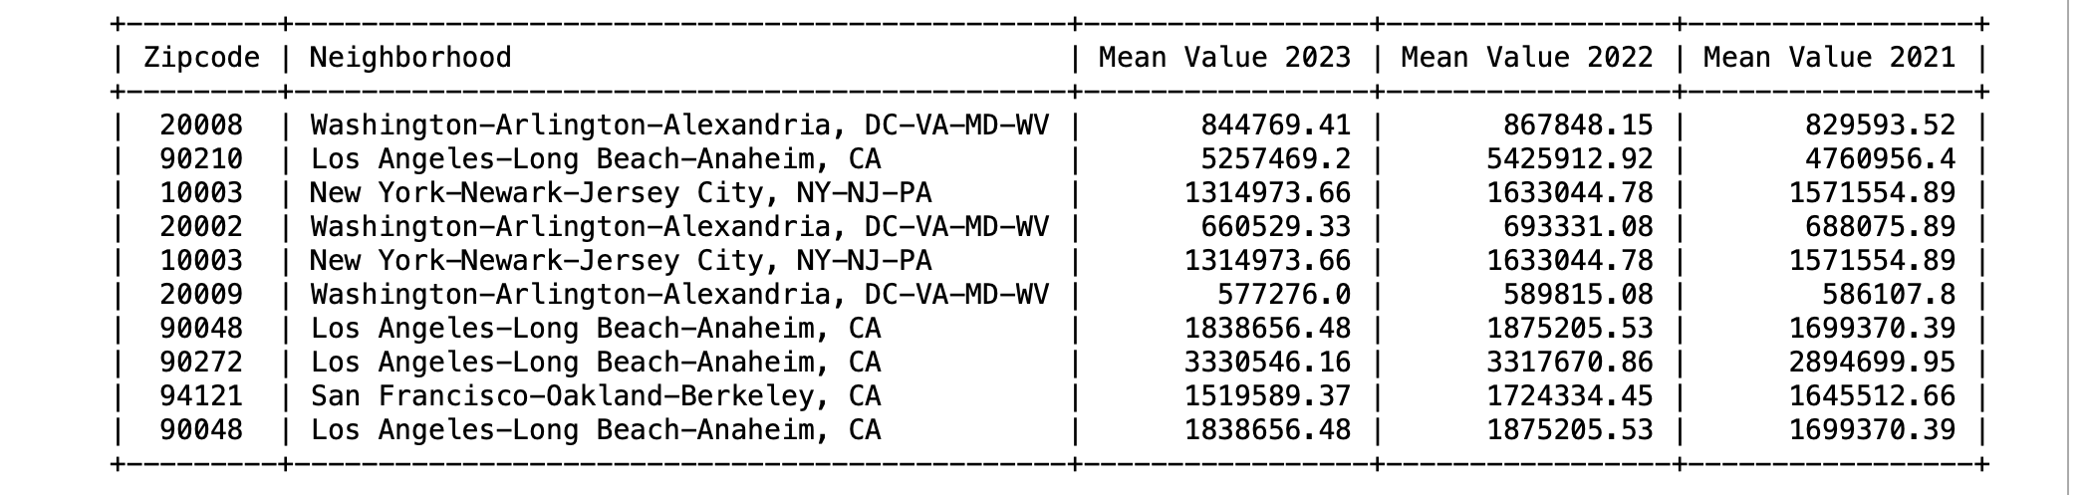
Top-10 neighborhood (mean Value)

Slide 15
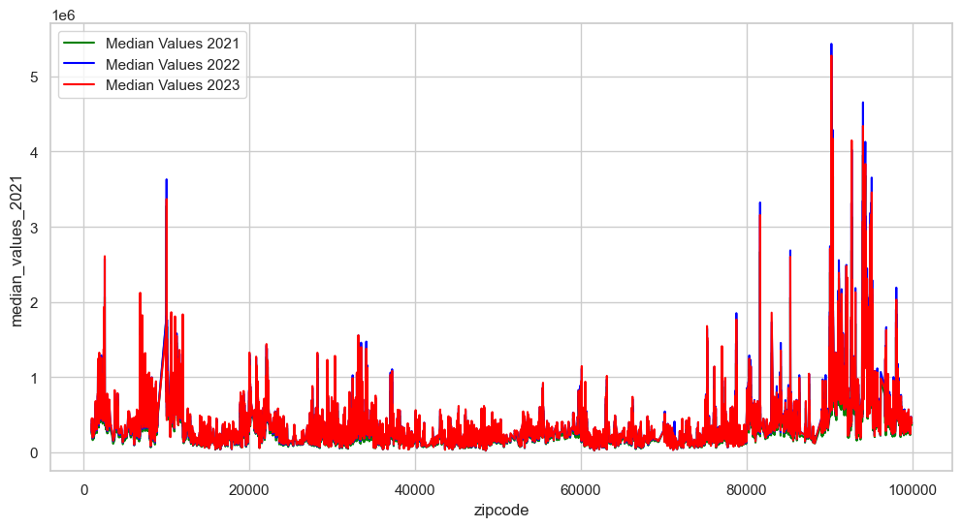
MEDIAN VALUES V/S ZIP CODE

Slide 16



Top 10 Zipcodes based on median values

Slide 17
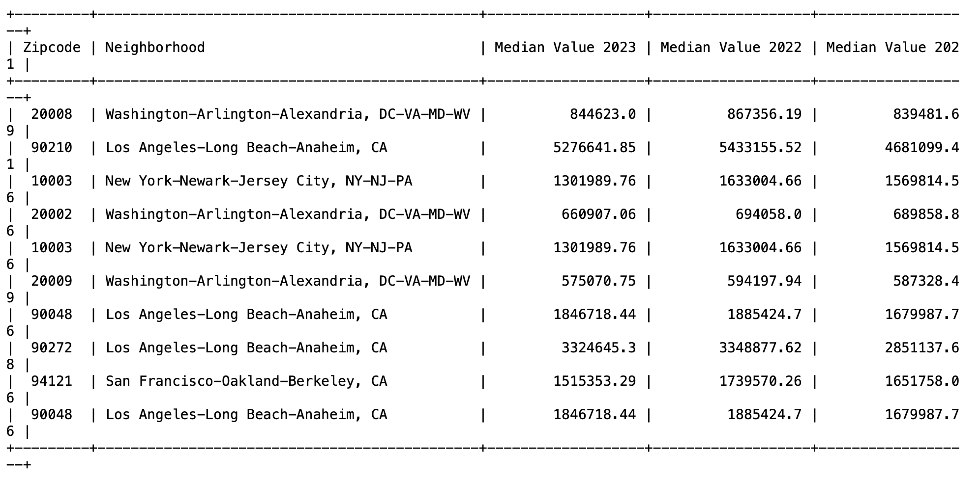
Top-10 neighborhood (Median)

Slide 18
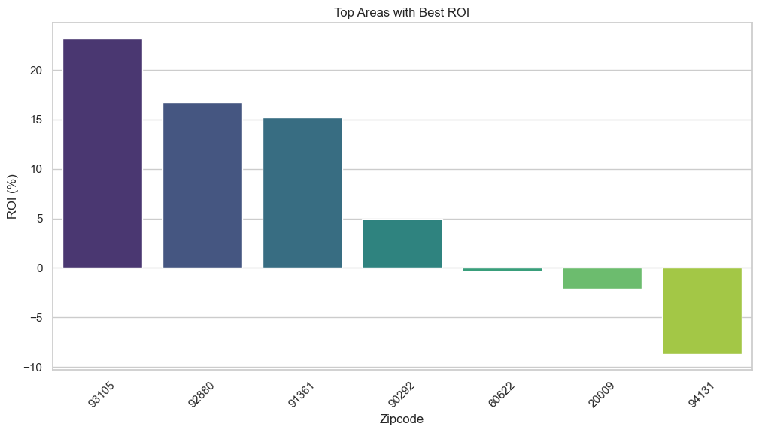
Top Areas with Best ROI

Slide 19
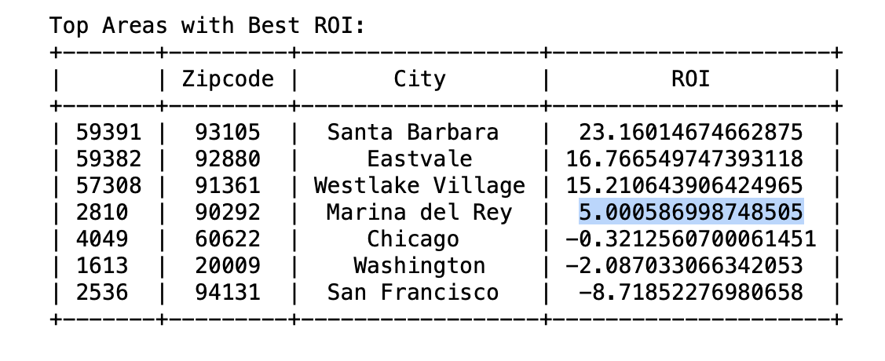
Top cities with best roi

Slide 20
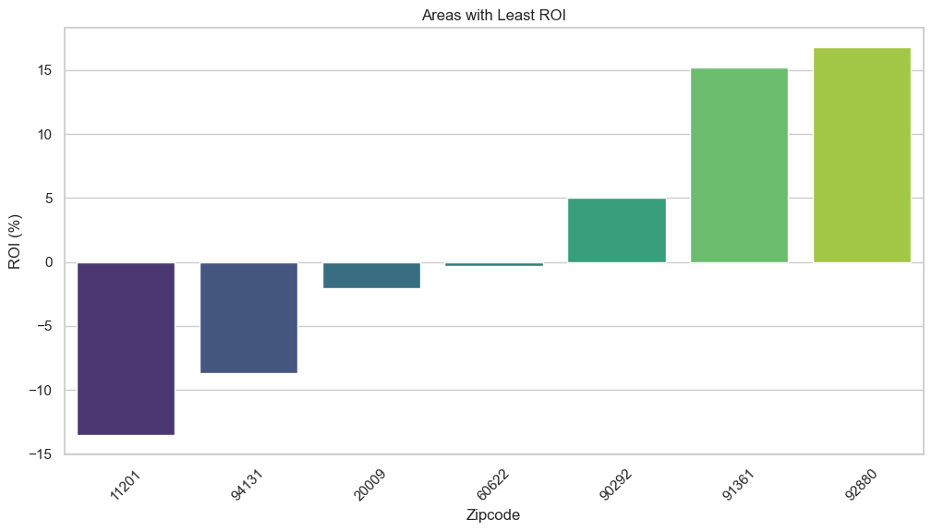
Cities with least roi

Slide 21
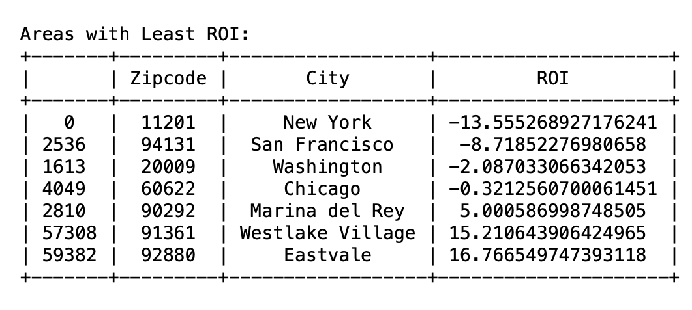
Cities with least roi

Slide 22
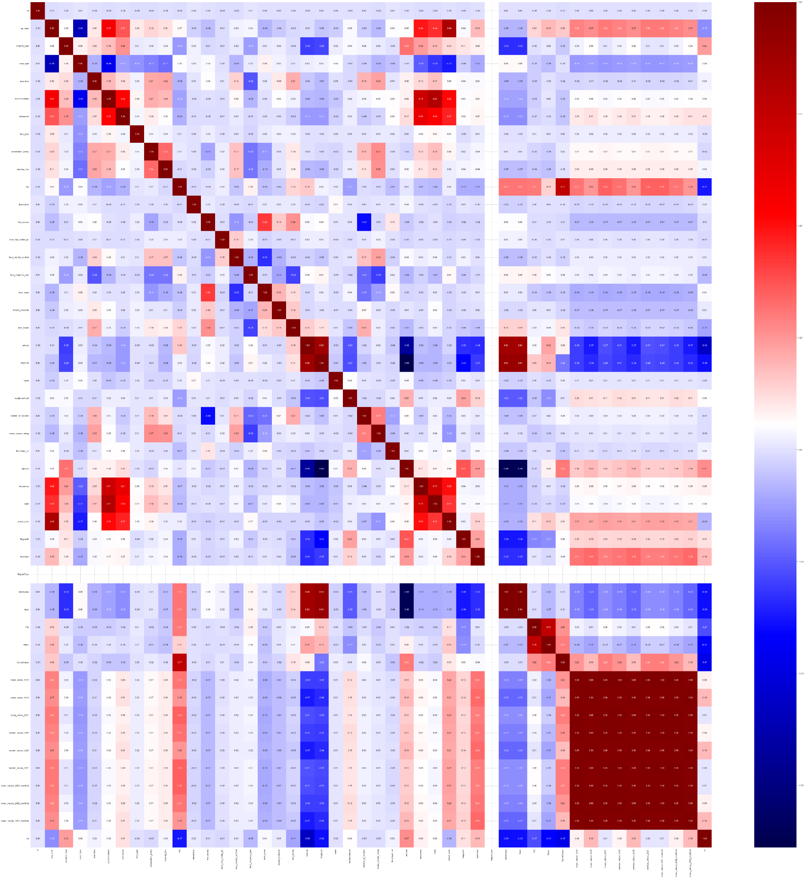
Heat map

Slide 23
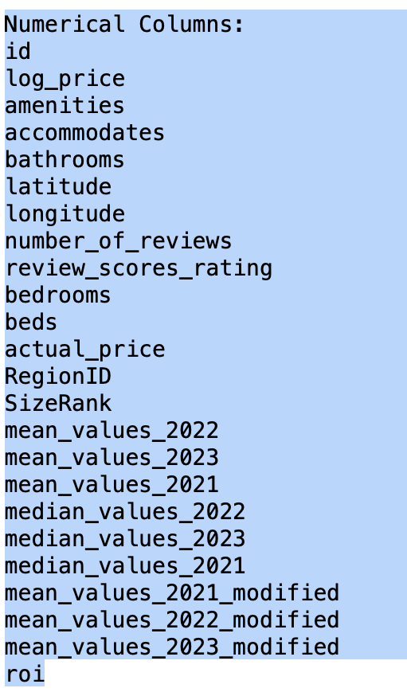
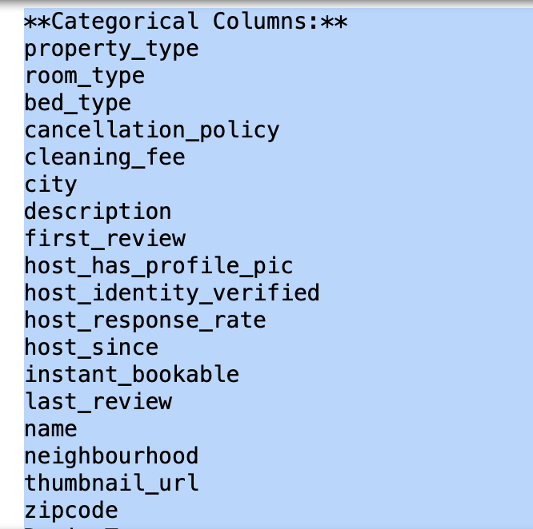
NUMERICAL AND CATEGORICAL COLUMNS

Slide 24
Machine learning techniques used
Linear Regression
Random Forest
Gradient Boosting
XGBoost

Slide 25
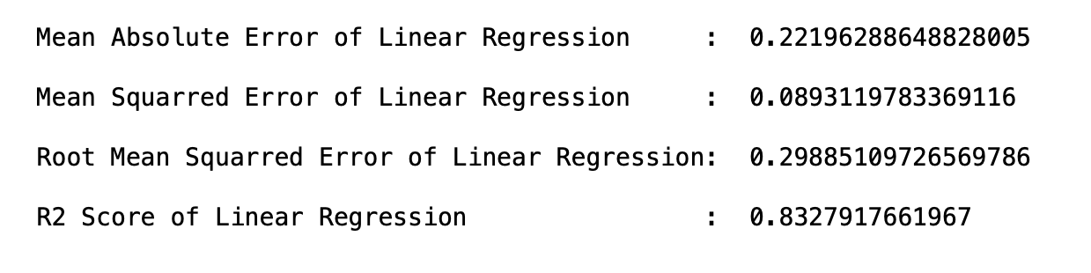
Linear Regression

Slide 26
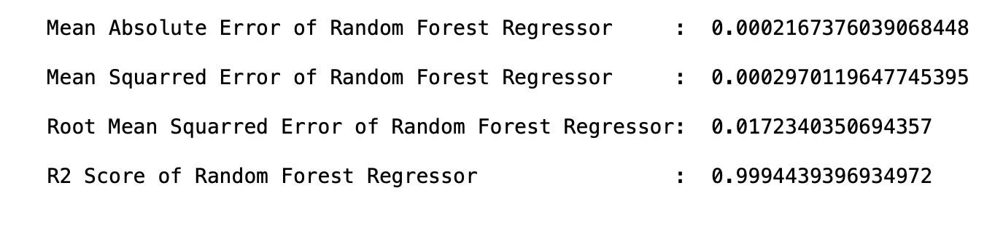
Random Forest

Slide 27
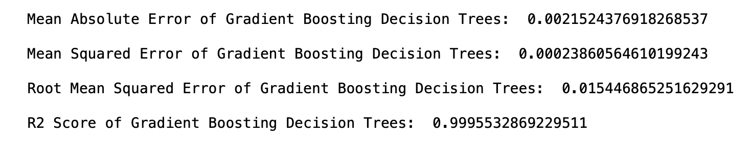
Gradient boosting

Slide 28
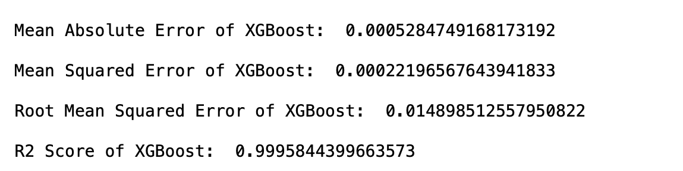
xG boost

Slide 29
Conclusion/Summary
Got the R^2 score by performing machine learning algorithms:
Linear regression: 0.83
Random Forest: 0.99
Gradient Boosting: 0.99
XGboost: 0.99
In conclusion, this project demonstrates the potential of machine learning in predicting Airbnb prices. By leveraging predictive analytics, both customers and hosts can benefit from informed decision-making and competitive pricing strategies.

